Slide 1
Automated script bash
Mayar Tarek 202002151
Malak Essam 202000935
Mohamed El Sayed 19105616
Nada Adel 202000554
Sarah Mahmoud 202000408
Shahd Fekry 202000908

Slide 2
TABLE OF CONTENTS
01
Introduction
04
FASTQ conversion
02
Pairwise alignment
03
MSA
05
K-mers count
06
Conclusion

Slide 3
Introduction !
Our program is a fully automated command line with a graphical user interface. By simply clicking the name of our application, the user can do a variety of operations automatically. For example, converting FASTQ to FASTA, counting K-mers, pairwise or multiple sequence alignment.

Slide 4
Pairwise Alignment
Local
Global
Smith waterman algorithm
Needlman Wunsch algorithm
Program | Query | Database | Alignment
Blastn | DNA | DNA | DNA
Blastp | Protein | Protein | Protein
Blastx | DNA | Protein | Protein
Tblastx | DNA | DNA | Protein
Tblastn | Protein | DNA | Protein
Finding similarities covering as much as possible from the sequence.

Slide 5
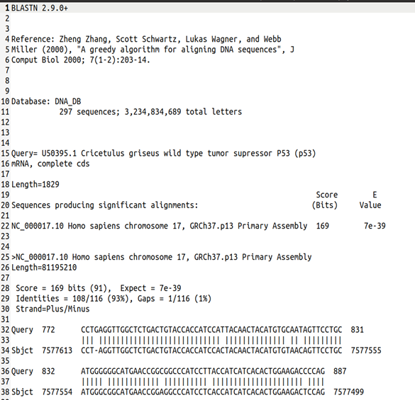
Local Alignment
Blastn:

Slide 6
Local Alignment
Blastp:
Blastx:
Tblastx:
Tblastn:

Slide 7
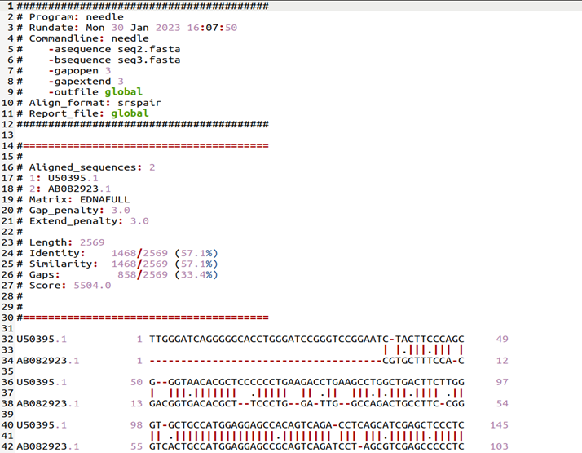
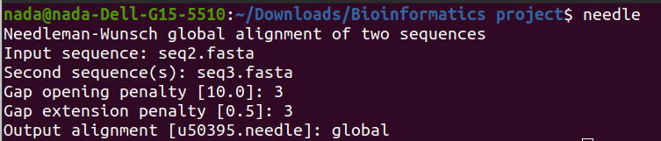
Global Alignment
Command Line
Output File

Slide 8
Multiple sequence alignment
Two algorithms perform the MSA:
Muscle
Kalign
Clustalw
HTML
MSF
Clustalw

Slide 9
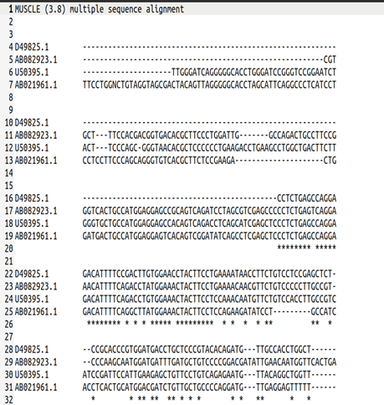
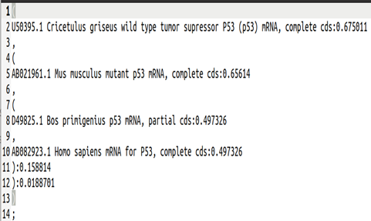
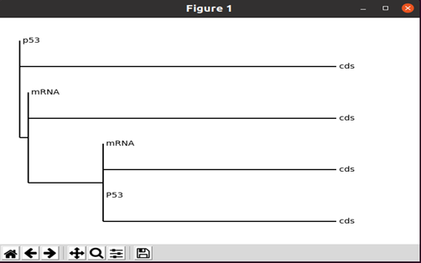
Muscle
Clustalw

Slide 10
Muscle
HTML:
MSF:

Slide 11
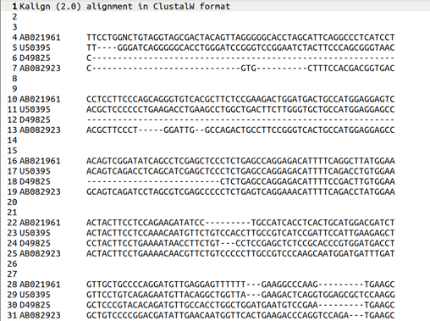
Kalign

Slide 12
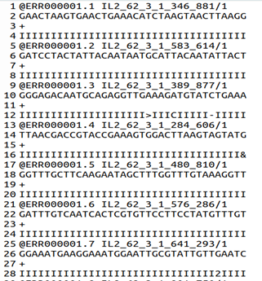
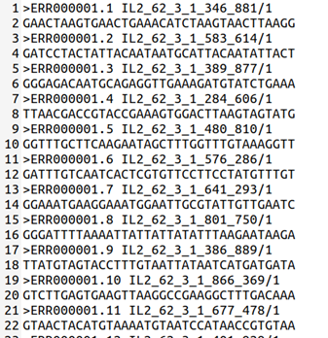
FASTQ to FASTA
Input file
Output file

Slide 13


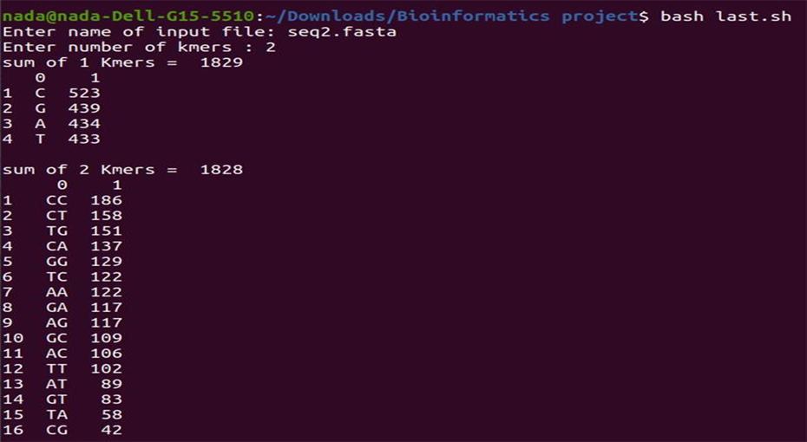
Counting Kmers
We implemented a Python code that counts all the K-mers with the input number that the user entered and called it in the bash script with the following Linux command:

Slide 14
Conclusion
The report explained the use of Linux as the preferred operating system for bioinformatics due to its robust command-line interface, and the development of a fully automated command-line application with a graphical user interface for easier use.

Slide 15
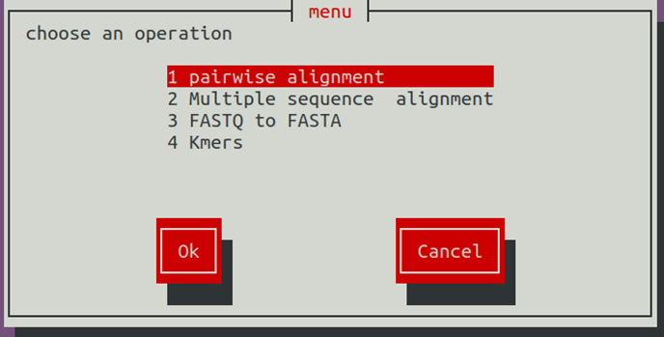
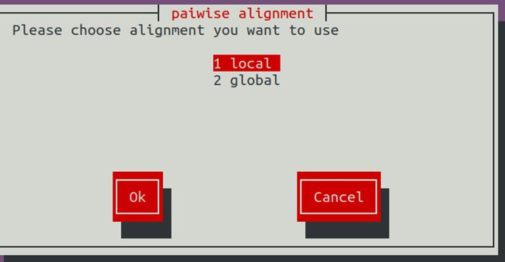
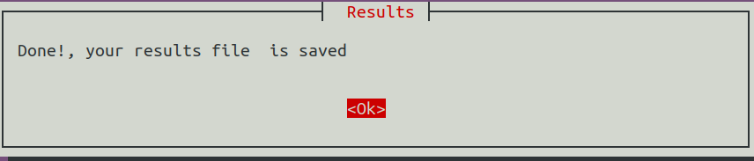
GUI Sample

Slide 16
References
Brihadiswaran, G. (2020) Bioinformatics 1: K-Mer counting, Medium. The Startup. Available at: https://medium.com/swlh/bioinformatics-1-k-mer-counting-8c1283a07e29#:~:text=What%20are%20k%2Dmers%3F,which%20consists%20of%2011%20nucleotides
Embl-Ebi Pairwise sequence alignment, EBI. Available at: https://www.ebi.ac.uk/Tools/psa/#:~:text=Pairwise%20Sequence%20Alignment%20is%20used,(protein%20or%20nucleic%20acid) .
National Center for Biotechnology Information. U.S. National Library of Medicine. Available at: https://www.ncbi.nlm.nih.gov/
(S.webteam), www-core (2022, February 21). What is bioinformatics and how do we use it? @yourgenome · Science website. Retrieved January 30, 2023, from https://www.yourgenome.org/facts/what-is-bioinformatics-and-how-do-we-use-it/

Slide 17
Thank you!

